Slide 1
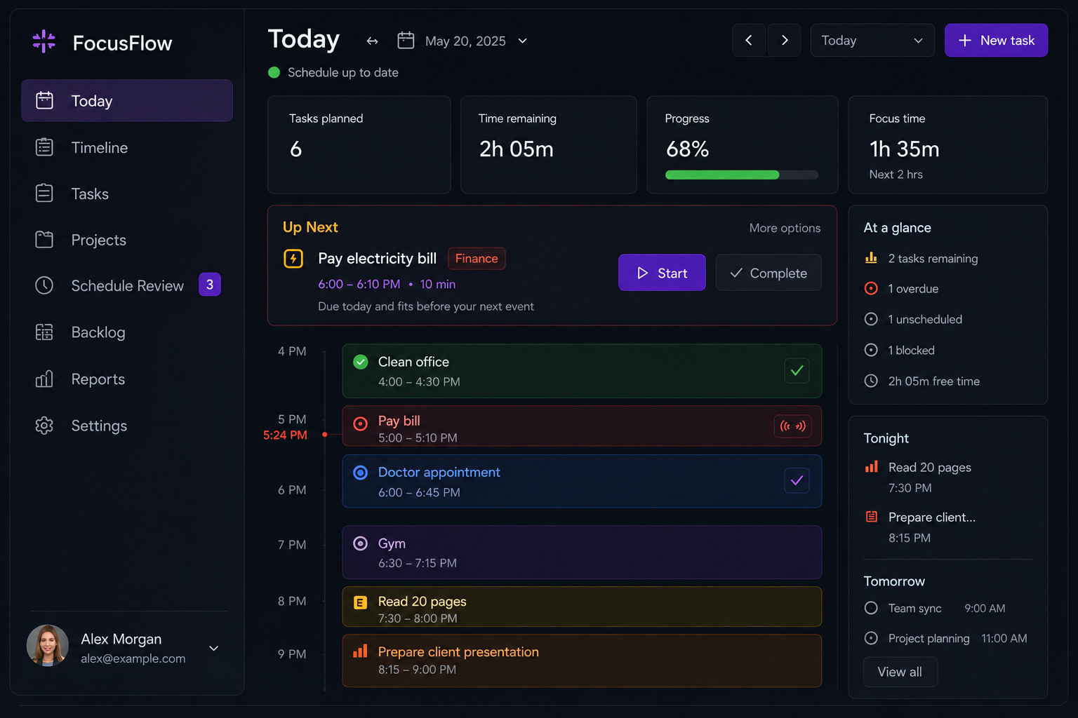
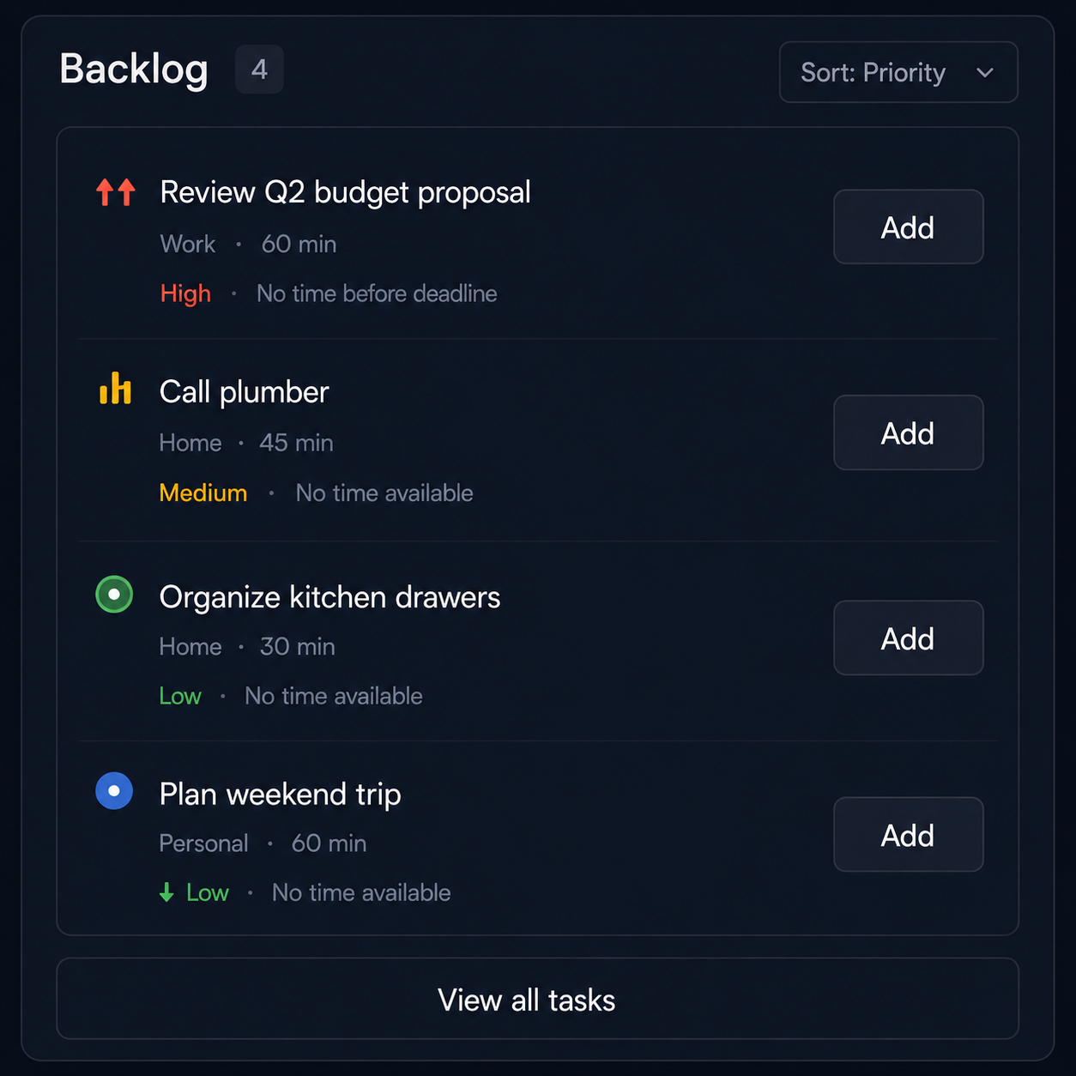
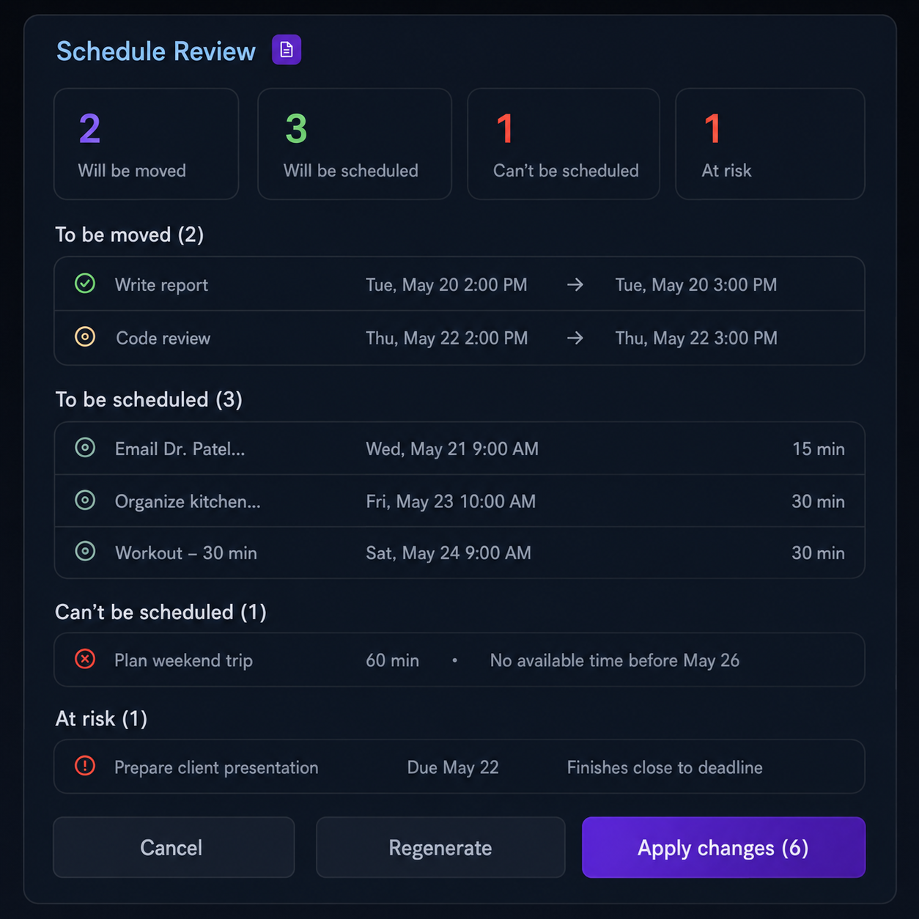
UX DESIGN DOCUMENT
FocusFlow
UX Interaction Flows
Dark-theme desktop flows for capture, scheduling, editing, and moving work between Today and Backlog.
01
Add a new task
02
Schedule it
03
Edit a scheduled task
04
Move Task A to Backlog, then schedule Task B
Implementation-oriented • derived from the current scheduling core and product specification

Slide 2
FOUNDATION
Interaction model
The interface should preserve intent when the plan changes, not force the user to rebuild the day.
EXPERIENCE CONTRACT
PRIMARY TASK STATE FLOW
Capture first; structure only when it is needed.
Flexible tasks may move. Critical, inflexible, and locked time stay fixed.
Backlog is a safe unified state, not a failure bucket.
Preview downstream moves before applying a multi-task change.
Use calm, specific language for no-fit, missed, and deferred states.
Keep one-tap actions visible: Done, Push, Backlog, Break up.
Capture
Backlog
Scheduled
Active
Missed / cancelled
Completed
Move to Backlog clears schedule placement. Scheduling again uses the current rules; the old slot is not restored.
V1 core
Today, Backlog, quick capture, flexible movement, child tasks, locked time
FUTURE V2 SURFACES
Week/month views, reports, drag-and-drop, history, Overwhelm Shield

Slide 3
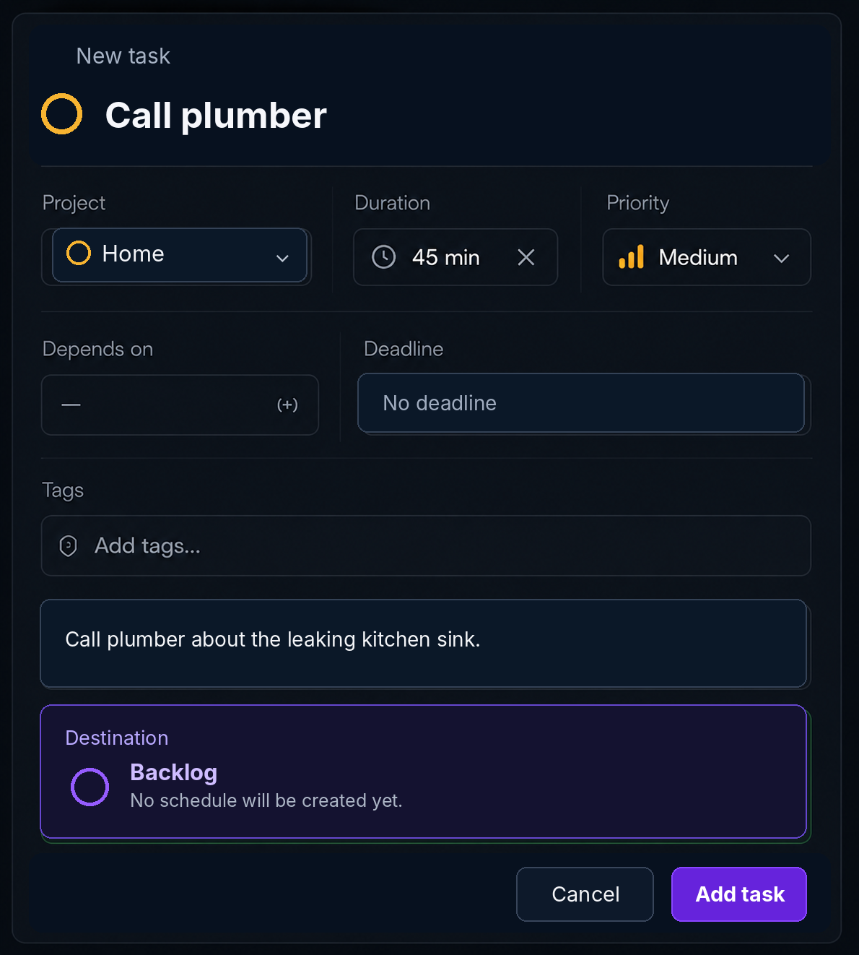
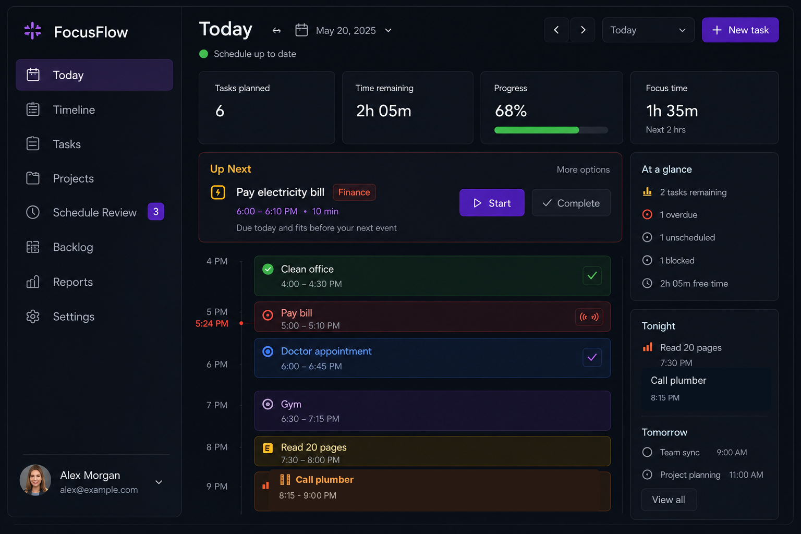
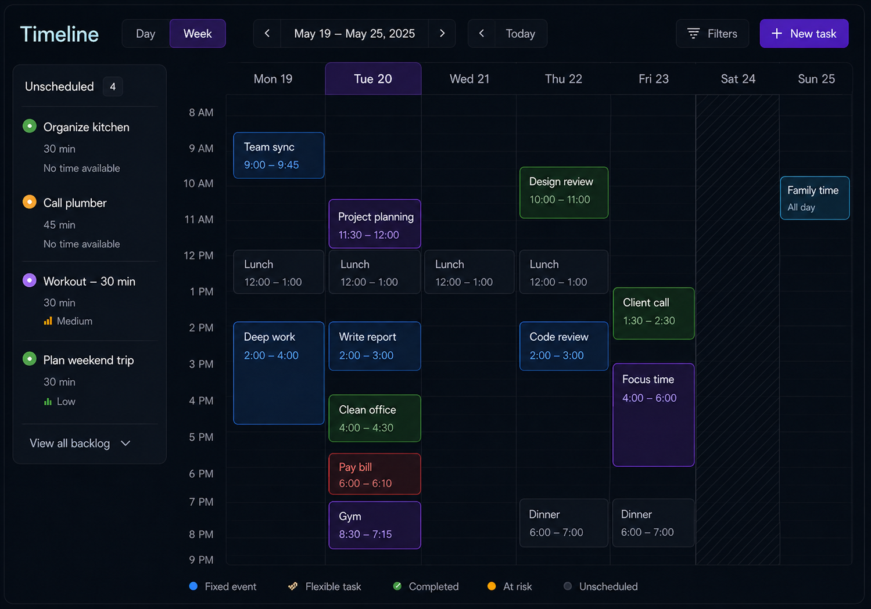
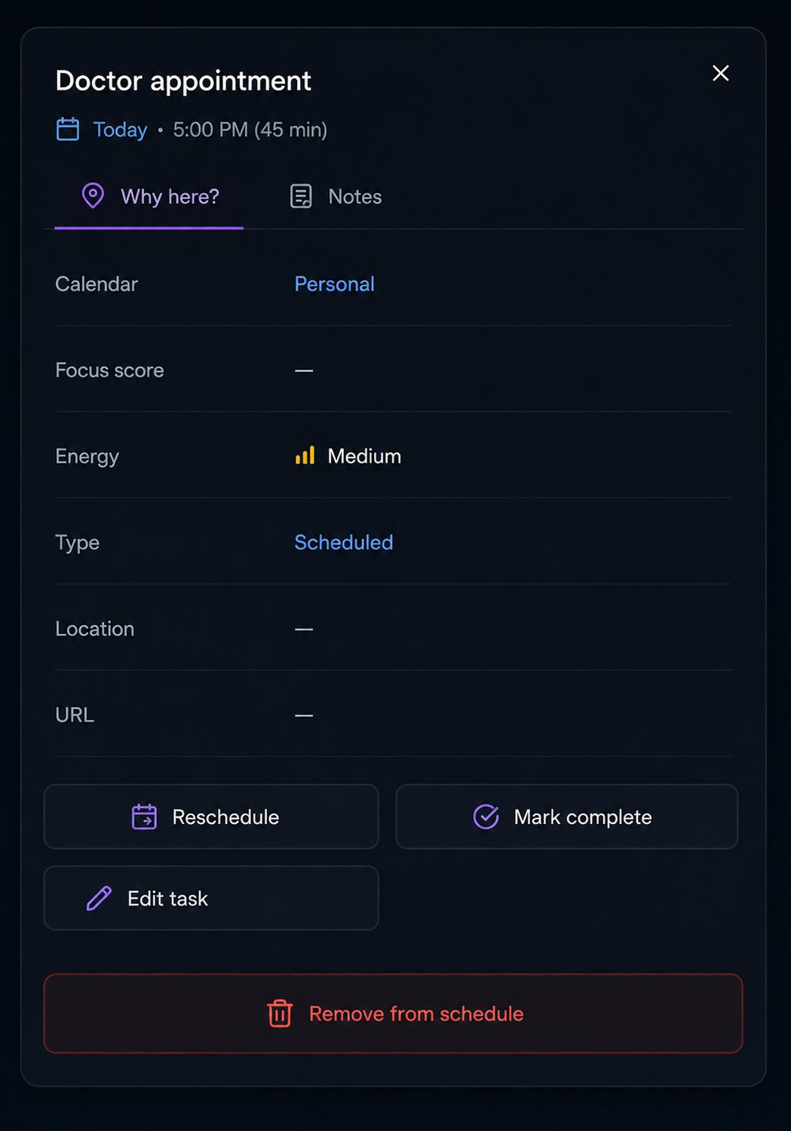
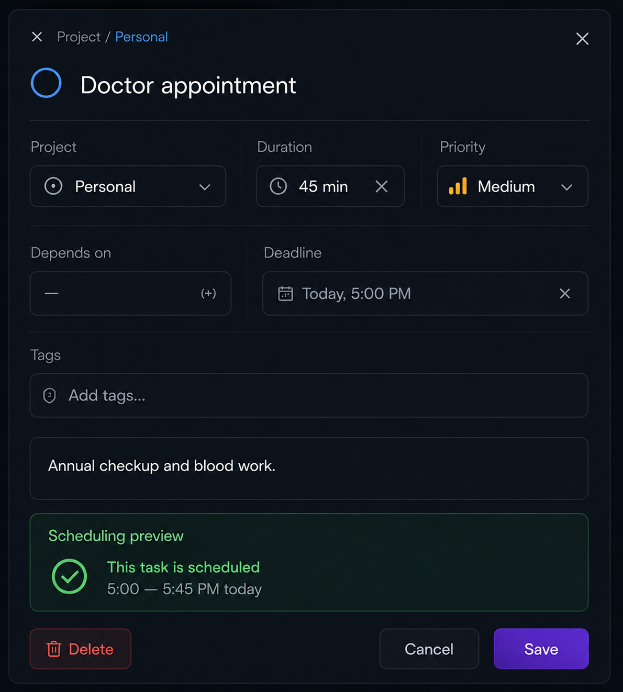
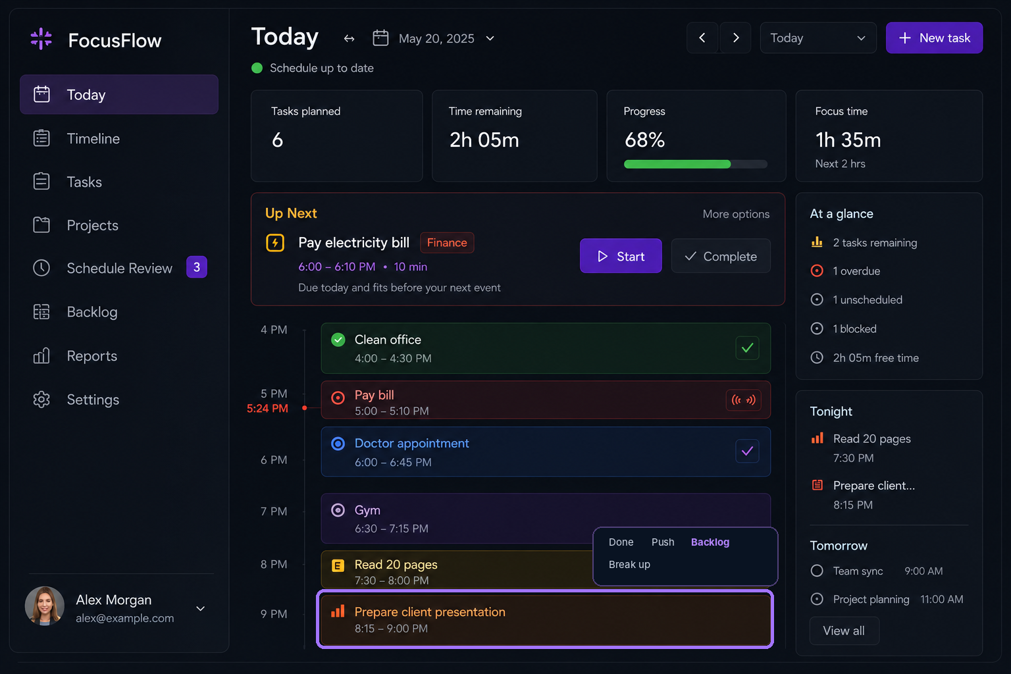
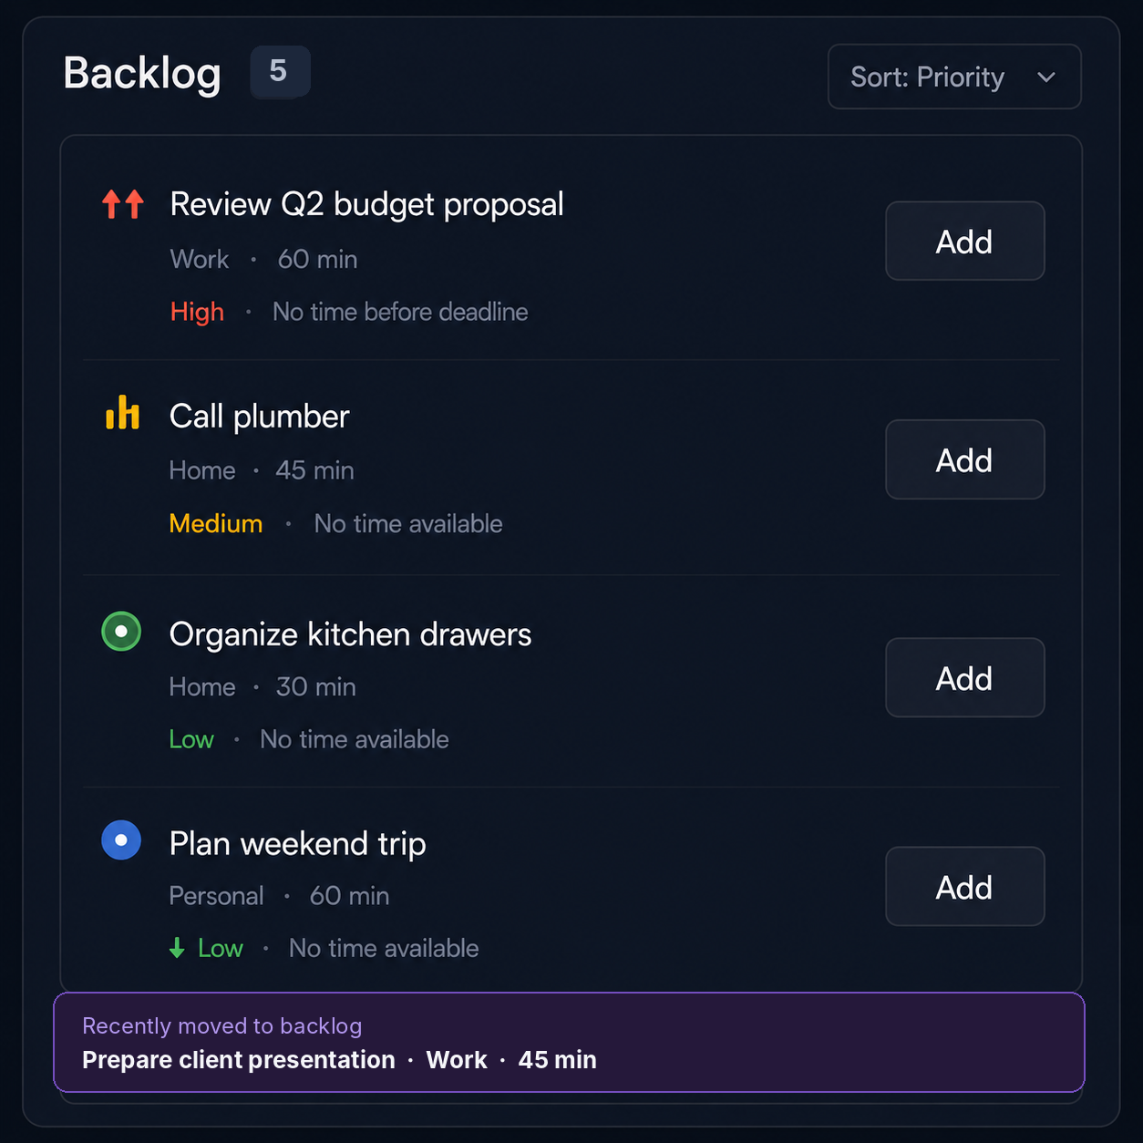
OVERVIEW
Four end-to-end user flows
Each path keeps the user in context and exposes only the decisions required at that moment.
01
Add a new task
Today
New task
Backlog
02
Schedule it
Backlog
Review
Today
03
Edit scheduled task
Timeline
Inspector
Editor
04
Replace Task A with Task B
Task A → Backlog
Choose Task B
Updated Today

Slide 4
FLOW 01 • ADD A NEW TASK
Start from Today
The creation flow opens over the current day rather than navigating the user away.
1
Select New task
Use the primary action in the top bar. The user remains anchored to Today and the selected date.
2
Open a reusable drawer
Create and edit use the same task editor shell. In create mode, fields are blank or neutral defaults.
3
Ask for one thing first
Title is the only required value. Duration can remain empty until the user chooses to schedule.
Initial UI state
Create mode • destination Backlog

Slide 5
FLOW 01 • ADD A NEW TASK
Enter the minimum and add
Quick capture should accept partial information without turning capture into planning.
1
Title is required
“Call plumber” is enough to create the task. Project, duration, deadline, tags, and notes remain optional.
2
Use neutral defaults
Project defaults to Inbox/Unsorted when blank. Priority is Medium. Reward and difficulty remain Not set.
3
Backlog is the default destination
Creating the task does not force a schedule decision. Duration may be entered now, but is required only when scheduling.
4
Add task
On success, close the drawer and show a quiet “Added to Backlog” confirmation. Empty-title validation stays inline and preserves input.

Slide 6
FLOW 01 • ADD A NEW TASK
Result: task is safe in Backlog
The new task joins the unified backlog rather than a separate capture silo.
1
Normal backlog row
Show title, project, duration when known, priority, and the reason it is not scheduled.
2
Ambient staleness only
The age marker begins fresh and changes over time. Do not create a prompt or warning stream per task.
3
One scheduling action
“Add” means insert into the earliest valid flexible slot. It should not open a manual time picker first.
Domain state after capture
status = backlog
scheduledStart = null • scheduledEnd = null

Slide 7
FLOW 02 • SCHEDULE IT
Select Add from Backlog
Scheduling is automatic: the user chooses the task, not a precise time.
1
Choose Add
The selected task is passed to the next-available-slot scheduler.
2
Validate only what scheduling needs
Immediate scheduling requires a positive duration and a flexible task type. Missing duration focuses the duration field instead of discarding the task.
3
Find the earliest valid slot
Skip locked time and required visible items. Preserve the order of later flexible tasks while moving them forward as needed.
No-fit branch
Keep the task in Backlog and explain the blocking constraint. Never lose the captured task.

Slide 8
FLOW 02 • SCHEDULE IT
Preview downstream changes
Use a full review only when scheduling affects other tasks, creates risk, or cannot place an item.
Example placement
Call plumber → 8:15–9:00 PM
1
Show every affected item
Separate newly scheduled, moved, unable-to-schedule, and at-risk outcomes. For moved tasks, show before and after times.
2
Keep decisions reversible
Cancel leaves the original task list untouched. Regenerate reruns the same rules against the current scheduling window.
3
Apply as one change set
Commit the selected task and all dependent placement changes together. Avoid partial saves.

Slide 9
FLOW 02 • SCHEDULE IT
Result: the task appears on Today
The final state communicates placement clearly and returns the schedule to a stable state.
1
Planned task card
Call plumber now has a concrete start and end. It leaves Backlog and appears in Today.
2
Schedule status resets
The “Schedule up to date” indicator returns after the change set is applied.
3
Moved flexible tasks update in place
Any downstream flexible tasks display their new times. Required and locked items remain unchanged.
Result state
planned • 8:15–9:00 PM

Slide 10
FLOW 03 • EDIT A SCHEDULED TASK
Select the task without leaving the schedule
A contextual inspector provides a fast read before the user commits to editing.
1
Inspector behavior
Details, Why here?, and Notes stay visible beside the timeline. “Edit task” opens the full editor.
Flexible-task label
Use “Move to Backlog.”

Slide 11
FLOW 03 • EDIT A SCHEDULED TASK
Edit fields and save
The editor separates harmless metadata changes from changes that can alter placement.
1
Edit task details
Title, project, notes, and tags normally save without moving the task.
2
Detect placement-affecting changes
Duration, flexibility/type, deadline, and future availability constraints trigger a new scheduling preview.
3
Explain the result inline
Show “This task is scheduled” when the existing slot remains valid. Show a specific no-fit reason when it does not.
4
Save or review
If no other task changes, save and close. If another task moves or risk appears, route to Schedule Review before committing.

Slide 12
FLOW 03 • EDIT A SCHEDULED TASK
Apply the revised schedule
Saving a schedule-affecting edit should be atomic and transparent.
Commit contract
Apply = edited task + every returned SchedulingChange. Cancel = original values and original placements.
Example
45 → 60 min moves one later flexible task; required blocks remain fixed.

Slide 13
FLOW 04 • SWAP SCHEDULED TASKS
Move Task A to Backlog
The first action explicitly removes a flexible task from the active plan.
1
Select Task A
Example: Prepare client presentation, 45 minutes, scheduled at 8:15 PM.
2
Choose Backlog
Expose Backlog directly on flexible task cards, or as Push → Backlog. Do not open a time picker.
3
Clear placement immediately
Set status to Backlog and clear start/end. Do not preserve the old slot or queue position for later restoration.
Important
Leave the new opening unfilled until the user selects Task B.

Slide 14
FLOW 04 • SWAP SCHEDULED TASKS
Schedule Task B into the newly available time
The scheduler still chooses the earliest valid slot; the user sees the exact placement before applying.
Final state
Task A • Backlog • no schedule
Task B • Planned • 8:15–9:00 PM
1
Select Task B
2
Confirm placement
3
Apply
In Backlog, choose Call plumber and click Add.
In this example, 8:15 PM is the earliest valid 45-minute slot. Review any downstream moves.
Task A stays safe in Backlog. Task B becomes planned. Fixed and required items remain unchanged.

Slide 15
HANDOFF
UI-to-core interaction matrix
Suggested Flutter orchestration based on the current pure Dart domain services.
UI event
Core operation
Expected result
UI feedback
Add task
QuickCaptureService.capture(addToNextAvailableSlot: false)
QuickCaptureStatus.addedToBacklog
Close drawer; quiet success; show backlog row
Add from Backlog
insertBacklogTaskIntoNextAvailableSlot
Replacement task list + notices + changes
Inline confirmation or Schedule Review
Move flexible task to Backlog
FlexibleTaskActionService → Backlog
Status backlog; schedule cleared; stat incremented
Remove card; show Backlog confirmation
Save placement-affecting edit
UI clones edit, analyzes/recomputes schedule
Valid placement, change set, or no-fit notice
Save directly, review, or recovery options
Cancel Schedule Review
Discard returned replacement list
No domain or persistence change
Return to prior screen and selection
Acceptance checks
Input is never lost • no-fit keeps the task safe • locked/required time never moves • all multi-task changes are visible before apply
Scope boundary
Week view, drag-and-drop, reports, history, and Overwhelm Shield remain V2 surfaces.

